Slide 1

Gestione psichiatrica per la terapia farmacologica e chirurgica
Fausta Micanti
Psichiatra e Psicoterapeuta
Scuola di Medicina Università Federico II Napoli

Slide 2


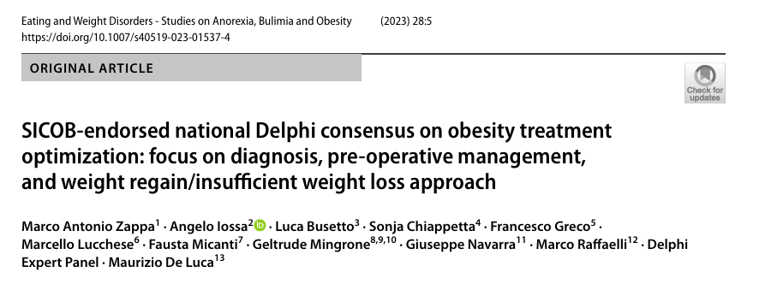

Slide 3
Interazione tra psicofarmaci e farmaci anti obesità
Interazione tra psicofarmaci e chirurgia bariatrica
Comportamenti alimentari come sintomo
Diagnosi
Procedure

Slide 4
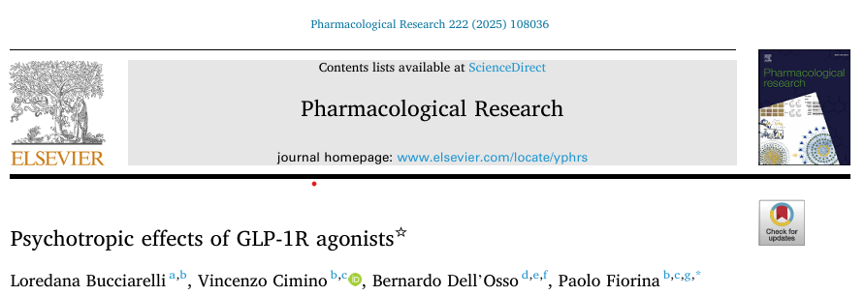
Gli studi più recenti hanno dimostrato la potenziale efficacia dell’impiego dei GLP-1 agonist (semaglutide,liraglutide) o dei dual agonist (tirzepatide) nei disturbi dell’umore e nel disturbo bipolare. I meccanismio d’azione sono complessi e relativi all’attivazione dei circuiti dopaminergici e alla riduzione del processo infiammatorio nei soggetti obesi
In antipsychotic-treated rats, liraglutide reversed depressive behaviors [24] and improved depressive and cognitive symptoms in high-fat diet models by enhancing hippocampal BDNF and reducing autophagy and inflammatory markers (TNF α , IL-6) [25]. Benefits in schizophrenia and bipolar disorder may involve synaptic plasticity and oxidative stress reduction [26]. In addiction models, GLP-1R agonists attenuate meso limbic dopamine release, drug-seeking, and relapse for cocaine, amphetamines, opioids, nicotine, and alcohol
GLP-1RAs modulate dopaminergic, serotonergic, and noradrenergic signaling, reduce neuroinflammation and oxidative stress, and enhance neuroplasticity, mechanisms relevant to psychiatric and substance use disorders [30]. Improved insulin sensitivity and reduced mitochondrial ROS may enhance serotonin signaling, contributing to antidepressant effects, in db/db mice treated with exendin-4

Slide 5
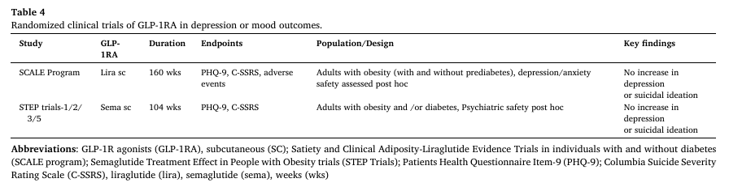
Psychotropic effects of GLP-1RAs: clinical studies GLP-1RAs may influence psychiatric conditions through several mechanisms, including enhanced neurogenesis and synaptic plasticity in mood-related regions such as the hippocampus [45] along with anti-inflammatory and antioxidant effects that may reduceneurodegenerative changes [22,46]. These actions are likely linked to the presence of GLP-1RAs in brain areas implicated in mood regulation -–hypothalamus, prefrontal cortex, hindbrain and amygdala–, where they modulate serotonin, dopamine and glutamate [24,47].
However, a small randomized clinical trial in obese patients affected with schizophrenia found no cognitive benefit with exenatide [50] highlighting the need for larger trials

Slide 6
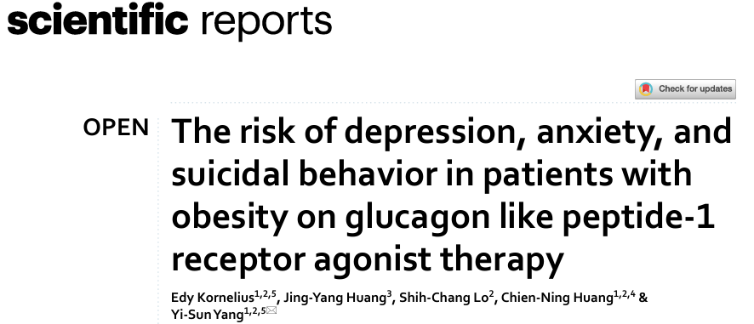
Moreover, one phase 2 study conducted by Astrup et al. investigated the effects of varying doses of liraglutide, ranging from 1.2 to 3 mg, in comparison to placebo and orlistat, expanding our understanding of the relationship between liraglutide and psychiatric outcomes. This study was inclusive of participants who had a history of psychiatric diseases. The results revealed a slightly higher rate of psychiatric disorders, particularly insomnia, depressed mood, and nervousness, in those taking higher doses of liraglutide (2.4 mg and 3.0 mg)). The study was later extended to a two-year follow-up period28. During this time, it was found that 17% of the participants had a history of psychiatric conditions, with insomnia being the most frequently reported issue.
…..While preclinical studies, primarily in animal models suggest a potential beneficial effect of GLP-1 RAs on mood and behavior, the clinical evidence in humans remains unclear. It is important to note that patients with a history of major depression were actually excluded from the phase 3 randomized controlled trials (RCTs) of these medications10–15,21–23. This exclusion is significant considering that patients with obesity have a higher risk of developing depression24. As a result, there is currently no data available to assess the clinical implications of GLP-1 RA use in this patient population

Slide 7
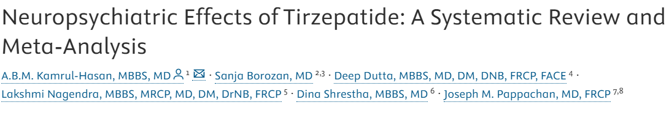

…… GLP-1RAs significantly interact with different neurotransmitter systems such as dopamine, glutamate, and γ-Aminobutyric acid and affect mood along with other aspects of mental health.⁴ A recent analysis of individual safety reports submitted to the EudraVigilance database revealed a low number of reported cases (1.2%); still, the potential for psychiatric events associated with the use of GLP-1RAs (semaglutide, liraglutide) and tirzepatide, pointing out the need for future targeted studies to assess the risk, particularly regarding suicidal thoughts.² Another study using the World Health Organization’s global database of suspected adverse drug reactions also found a signal of semaglutide-associated suicidal ideation.⁵ However, the other retrospective cohort study of electronic health records from the TriNetX Analytics Network does not support higher risks of suicidal ideation with semaglutide compared with non-GLP-1RA anti-obesity or anti-diabetes medications.⁶ In accordance, there is a rising concern about the neuropsychiatric effects due to GLP-1RAs and tirzepatide use, and its clinical implications and consequences are still to be fully addressed.

Slide 8

www.thelancet.com Vol 80 February, 2025
Reassuring though it is, current real-life information does not entirely fill this gap. Some pharmacovigilance case reports and studies have raised concern, but the results are mostly inconsistent.7–9 Results from pharmaco-epidemiological studies are more homoge neous, at least in their direction; however none of the currently published studies clearly addresses the issue of safety in patients with preexisting mental health disorders.10–14 This appears an important gap, firstly given the increasing use of GLP-1 RA use in obese patients who are at increased risk of suicidality, and secondly given the potential of use of these drugs in patients treated with antipsychotics or antidepressants that can induce important weight gain. Recommendations from the agencies currently remained opposite. The FDA recommends close monitoring for mood changes, emerging or worsening depression, or suicidal behavior during treatment by the GLP-1 RA liraglutide and semaglutide. Conversely, the European Medicines Agency (EMA) has concluded that evidence is insuffi cient to support a causal association.17,18 This contrasting information might lead to situations of complex

Slide 9
Modifica dell’assorbimento dei farmaci nel post-intervento
Modifica della formulazione
Farmaci assunti nel periodo preintervento
Interazione fra psicofarmaci e chirurgia

Slide 10
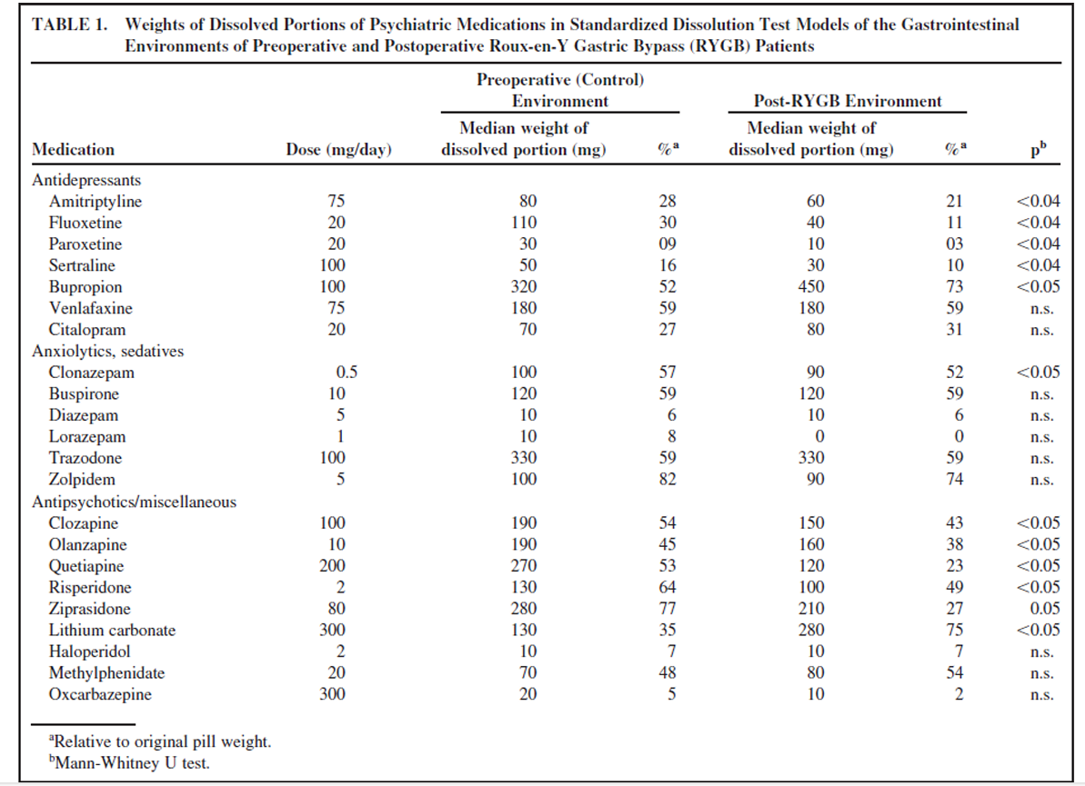

Slide 11
Ansia
Disturbo del tono dell’umore
Sintomi sottosoglia
Disturbo del sonno
Disregolazione emotiva
Impulsività
Grazing
Sweeteating
Binge
Food Addiction
Psicopatologia espressa dai comportamenti alimentari
Insonnia
NES
Depressione
Idealizzazione della magrezza

Slide 12
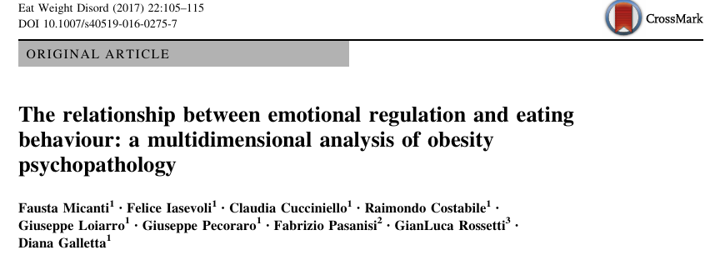
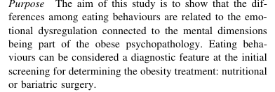
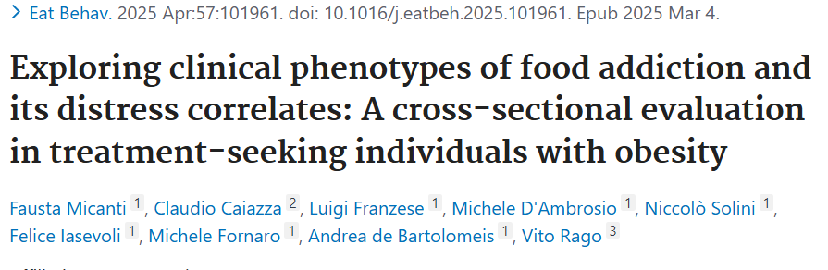
FA represents a frequent phenomenon in obesity, often driven by low distress tolerance and poor emotional regulation, mirroring other addictions. Pathological eating behaviors may represent different phenotypic expressions of FA. Considering the relevant psychological underpinning, integrating tailored psychological interventions into obesity management may promote sustained weight management and improved outcomes.

Slide 13
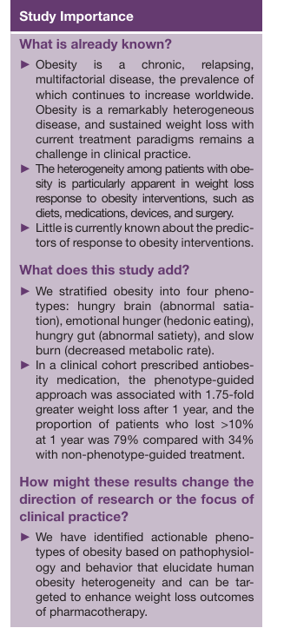
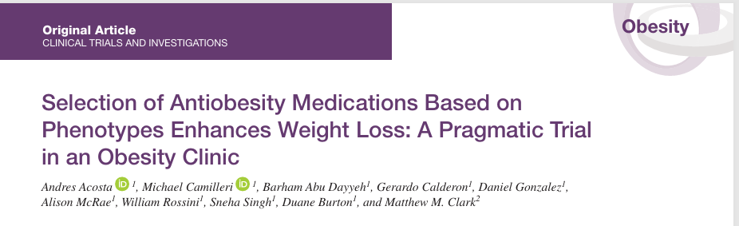

Slide 14
In SURMOUNT-1, participants receiving tirzepatide reported significant improvements in the Impact of Weight on Quality of Life-Lite Clinical Trials Version (IWQOL-Lite-CT) physical function domain scores compared to placebo, suggesting improvements in weight-related quality of life.
While these appetite-suppressing effects are well-documented in the context of obesity and diabetes management, the specific impact on binge eating behaviors has not been systematically studied in dedicated BED populations. The mechanisms by which tirzepatide affects appetite—particularly its influence on reward pathways and impulsivity related to food—suggest theoretical potential for reducing binge episodes. However, binge eating disorder involves complex psychological, behavioral, and neurobiological factors beyond simple appetite dysregulation, including emotional eating, stress responses, and learned behavioral patterns that may not be fully addressed by pharmacological appetite suppression alone.
Tirzepatide e BED

Slide 15
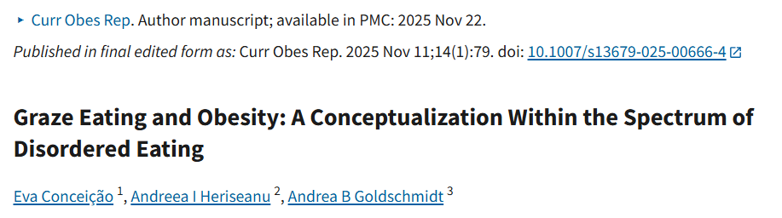
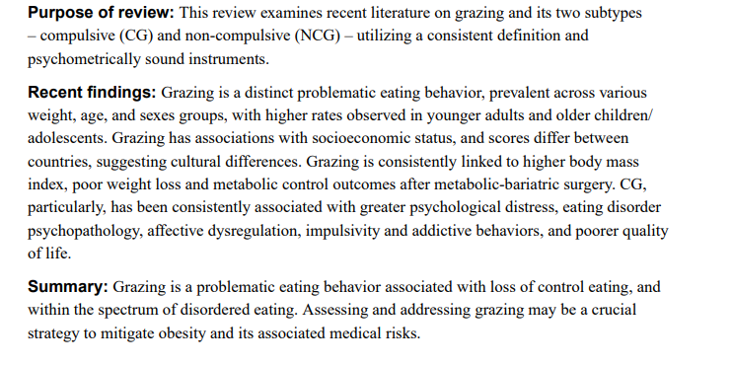

Slide 16
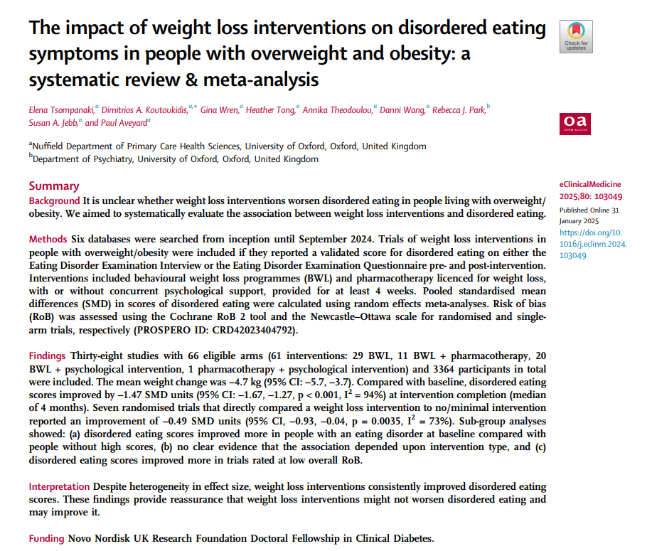

Slide 17

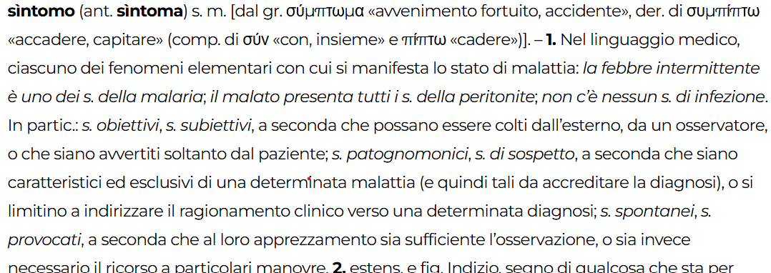
sintomo
colloquio
Raccolta
anamnestica
Conoscenza e
concettualizzazione
Diagnosi e Terapia

Slide 18

diagnosi
Processo
L’acquisizione degli elementi della conoscenza avviene attraverso il colloquio e l’impiego di oggetti strumentali atti aobiettivare i dati raccolti
L’operatore
La validità del processo dipende:
dïàgnoṡi s. f. [dal gr. διάγνωσις, dal tema di διαγιγνώσκω «riconoscere attraverso»]. – 1. In medicina, giudizio clinico che consiste nel riconoscere una condizione morbosa in base all’esame clinico del malato, e alle ricerche di laboratorio e strumentali: fare la d., formulare una d.; d. esatta, errata, e indovinare, sbagliare la diagnosi.
Dalle conoscenze dell’operatore
Dalla sua capacità di ascolto
Dalla sua capacità di operare una sintesi
Il paziente
Capacità di essere nella situazione
Motivazione
Empatia

Slide 19
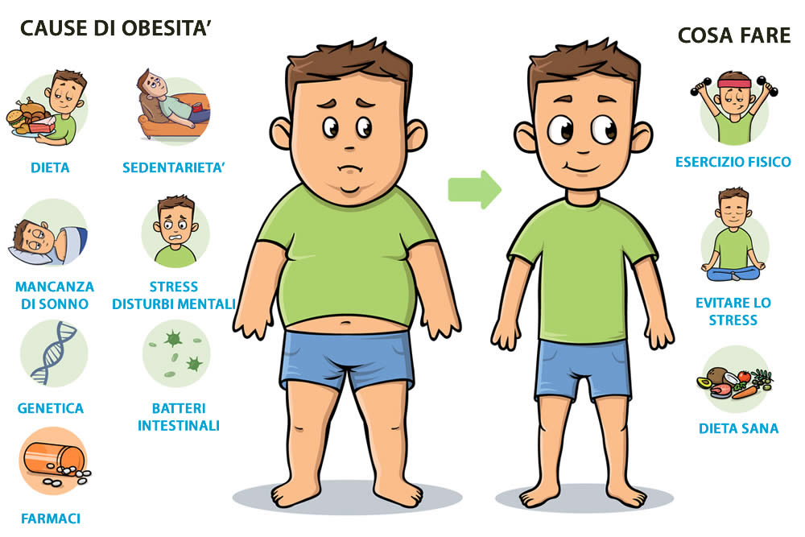

Slide 20
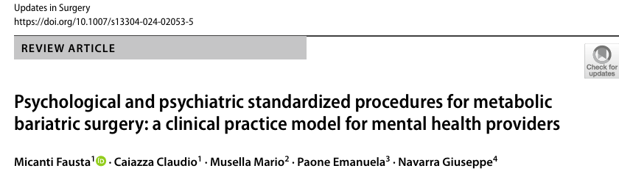
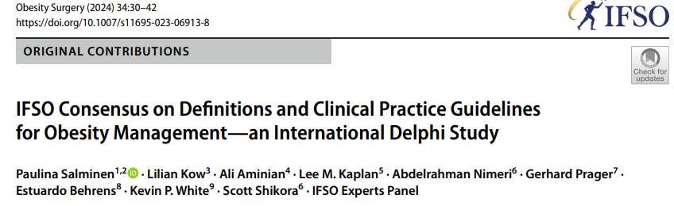


Slide 21
Grazie

